Slide 1
20 - Review
Dr. Rafael Kuffner dos Anjos

Slide 2
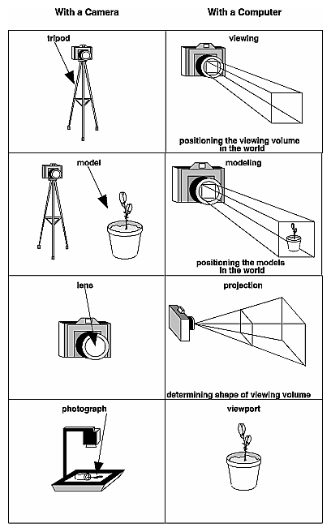
1. Projective Rendering
Standard Coordinate Systems
Projective Rendering
Painter’s Algorithm
Depth (Z-) Buffer
Projective Pipeline
Geometry / Raster / Fragment Stages

Slide 3
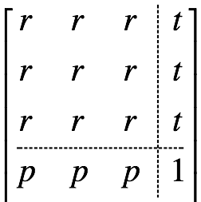
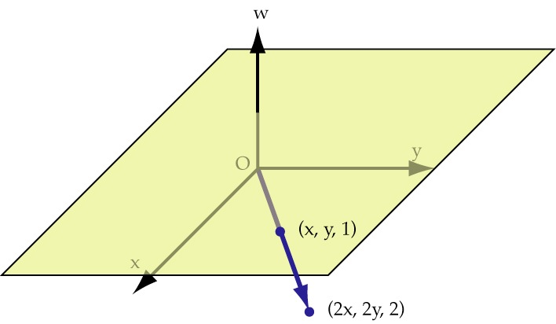
2. Homogeneous Coords
Projective Nature of Homogeneous Coords
Conversion to/from Cartesian Coords
Rotation Matrices
Translation Matrices
Rotation around Arbitrary Point
Orthogonal & Perspective Projection
Speed Advantages

Slide 4
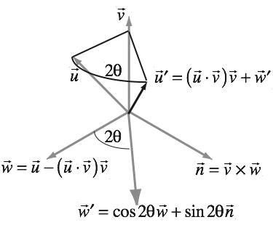
3. Quaternions
Fundamental maths for rotations
Used very heavily in animation
Gimbal locks, great circles
Complex numbers & transformations
Action of a Quaternion
Conversion to/from matrix
Arcball controller

Slide 5
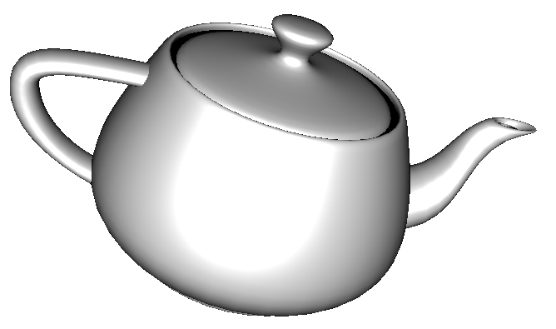
4. Rasterization & Blinn-Phong Lighting
Normal & Parametric Forms of a Line
Linear Interpolation
Raster Scan Algorithm
Half-Plane Test
Barycentric Coordinates
Local vs. Global Illumination
Specular (Glossy, not Mirror)
Diffuse (Lambertian)
Ambient (approximates Local Illumination)
Emissive

Slide 6
5. Texture Mapping
Mapping From Manifold to Surface
Forwards (u,v -> x,y,z)
Backwards (x,y,z -> u,v)
Bilinear Interpolation
Replacement vs. Modulation
Mipmaps
Uses & Construction

Slide 7
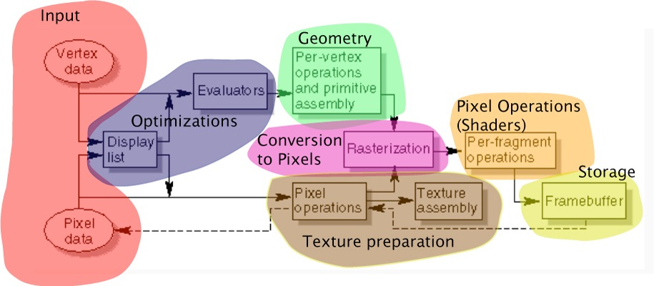
6. Pipeline Implementation
Pipeline Stages
State & Queues
Pipeline Flush
Framebuffer
TransformVertex()
RasterisePrimitive()
ProcessFragment()

Slide 8
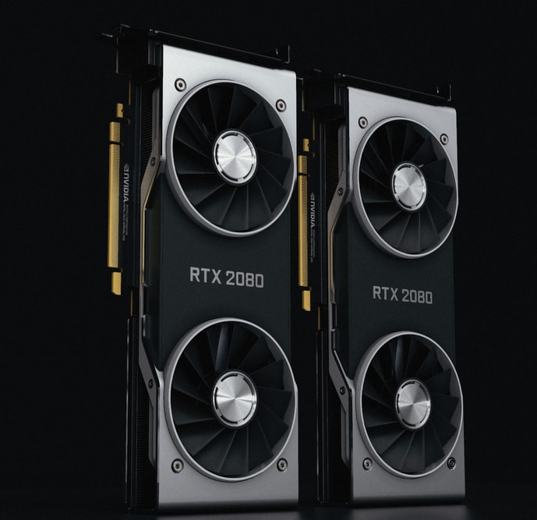
7: GPU Architecture
Details of the typical architecture
SIMD Parallelism
Standard Modern Pipeline
And the standard stages
With their uses
Malleability of stages
Compute shaders

Slide 9
8. Flushing & Buffers
When to Flush
How to Flush
Vertex buffer location: RAM/VRAM/shared
Packaging attributes
Transfer via staging buffer
Access via layout & location

Slide 10
9. GLSL
Shaders & SPIR-V
Shader compilation, language & I/O
Types, I/O & Descriptors
Uniform buffers for constants

Slide 11

10. Phong Shader
Vertex shader transforms & outputs normals
Rasteriser interpolates normals
Fragment shader computes Blinn-Phong
GLSL example
Geometry Shader example for splats

Slide 12
11. Physics of Light
Photons: Orbitals, Absorption, Emission
Wave-Particle Duality
Diffraction, Polarisation, Reflection, Refraction
Integrating Radiance (5-deep integral)
Angular Dependence
Lambertian Reflectance

Slide 13
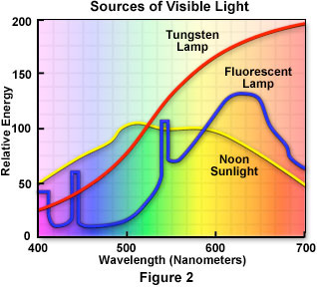
11. Colour & Perception
Spectral Distribution
Rods & Cones
Luminance
Tri-Stimulus Theory
Gamma Encoding
Colour Spaces

Slide 14
12. Materials & Scattering
Scattering Functions (BSDFs)
Finding Surface Frames
Sources of BSDFs
Blinn-Phong Shading
Add Specular Reflection / Refraction
Replace Ambient
Translucency & Opacity

Slide 15
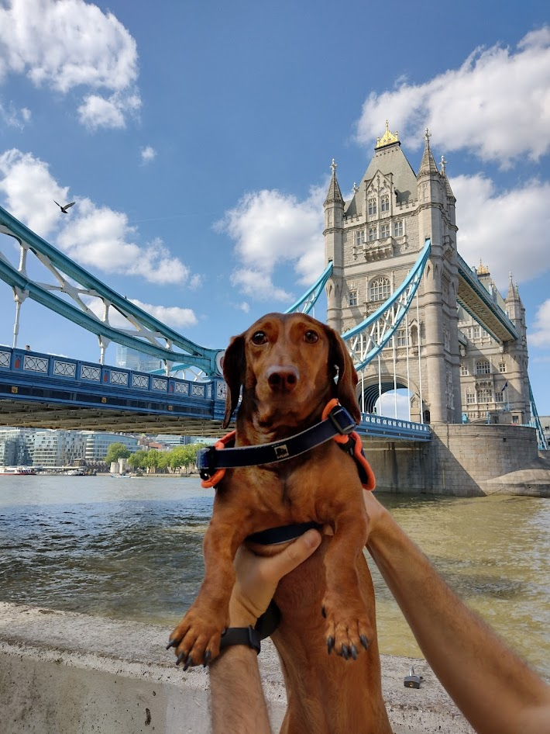
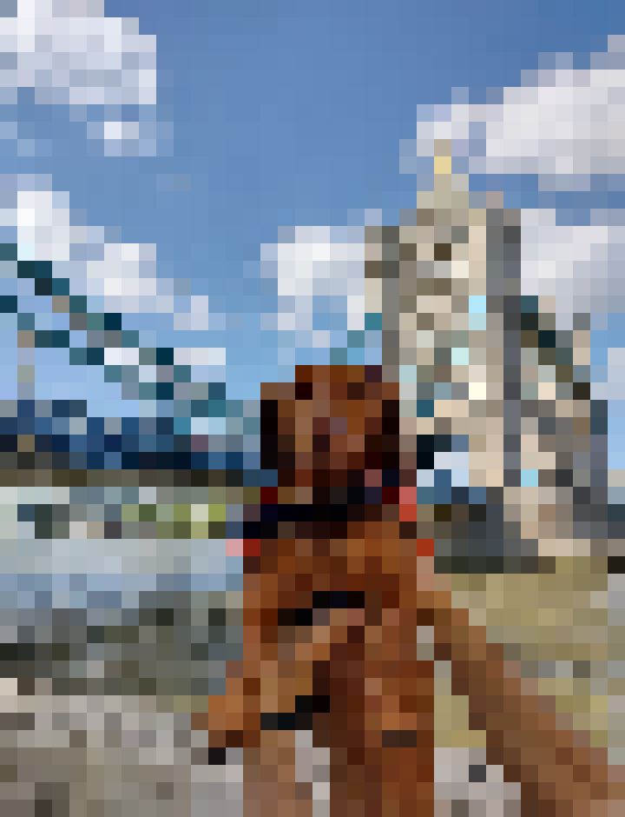
13. Filtering & Scaling
Continuous vs. Discrete Images
Reconstruction, Aliasing & Filtering
Convolution
Blurring
Fourier Analysis
Frequency Filtering
Scaling Down / Up

Slide 16
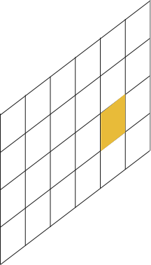
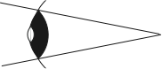

14. Raytracing / Intersection
Ray Casting & Visibility
Shadow Rays
Geometric Intersections
Line-Sphere
Line-Plane
Line-Triangle
Triangle-Triangle
Plane Π
Ray R
Point P
Eye E
Pixel π

Slide 17
15. Monte Carlo Sampling
Random Numbers
Mean, Variance & Standard Deviation
Importance Sampling
Monte Carlo Sampling
Weighting Sampling Directions
$$f:\left[0,1\right]×\left[0,1\right]→H:\left(u,v\right)→(\cos\left(2πu\right),v,\sin\left(2πu\right))$$

Slide 18

16. Practical Raytracing
Rendering Equation
Basic Path Tracer
Direct Point Lights
Indirect Point Lights
Recursive Scattering
Transmissive Terms
Recursive Path Tracer
Emissive Term for Area Lights
Direct Term for Point Lights
Direct Monte Carlo Term for Area Lights
Impulse Scatter for Reflection/Transmission
Indirect Light for Everything Else
Randomised Direction & Extinction Factor
$L^{ref}\left(P,ω_{0}\right)=\int_{ω_{i}∈S_{+}^{2}\left(P\right)}^{ }{L\left(P,−ω_{i}\right)f_{r}\left(P,ω_{i},ω_{0}\right)\left(ω_{i}∙\vec{n_{p}}\right)}\text{d}ω_{i}$

Slide 19
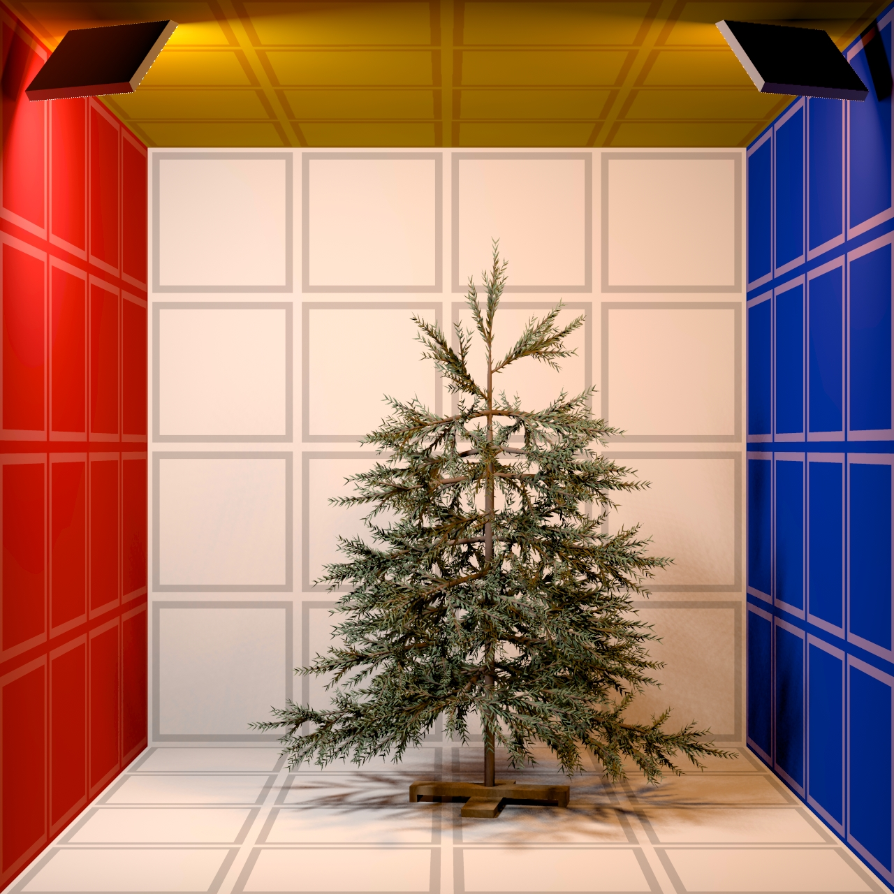
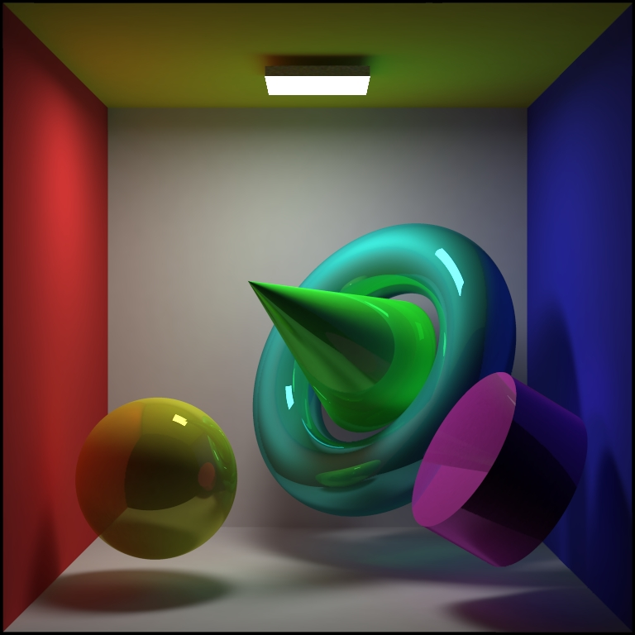
17. Alternative Rendering Solutions
Radiosity
Path Tracing (Kajiya)
Bidirectional Path Tracing
Metropolis Light Transport
Photon Mapping
Image-Space Photon Mapping
All of the stuff we don't use

Slide 20
18. NPR
Style, Intent, Message, Abstraction
Role of Strokes
Simplify, Factorise, Schematise
Silhouette Detection from Normals
Curvature Lines
Cel (Toon) Shading

Slide 21
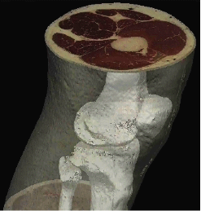
19. Volume Rendering
Volumetric Functions
Meshes & Interpolation
Isosurfaces
Normal Vectors & Central Differencing
Volume Rendering Integral
Transfer Functions
Pseudocode

